Slide 1
NEXT WORD PREDICTION USING RECURRENT NEURAL NETWORK
PRESENTED BY : KARTHI M
GUIDED BY : PROF. NIDA PARKER

Slide 2
INTRODUCTION
Next word prediction with Recurrent Neural Networks (RNNs) enhances typing efficiency by suggesting probable words based on preceding text.
This technology is pivotal in improving user experience across digital platforms like messaging apps and search engines.
By analyzing large text datasets, RNNs learn language patterns to offer accurate and contextually relevant predictions, facilitating seamless text input for users.

Slide 3
PROBLEM STATEMENT
Develop a next word prediction system leveraging Recurrent Neural Networks (RNNs) to enhance user typing efficiency across digital platforms.
Address the need for accurate and contextually relevant predictions by analyzing extensive text datasets and implementing advanced machine learning techniques within the model.

Slide 4
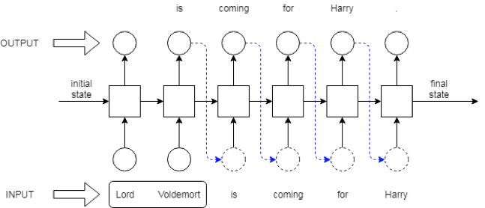
ARCHITECTURE

Slide 5
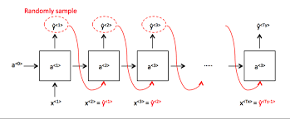
ARTCHITECTURE Contd…

Slide 6
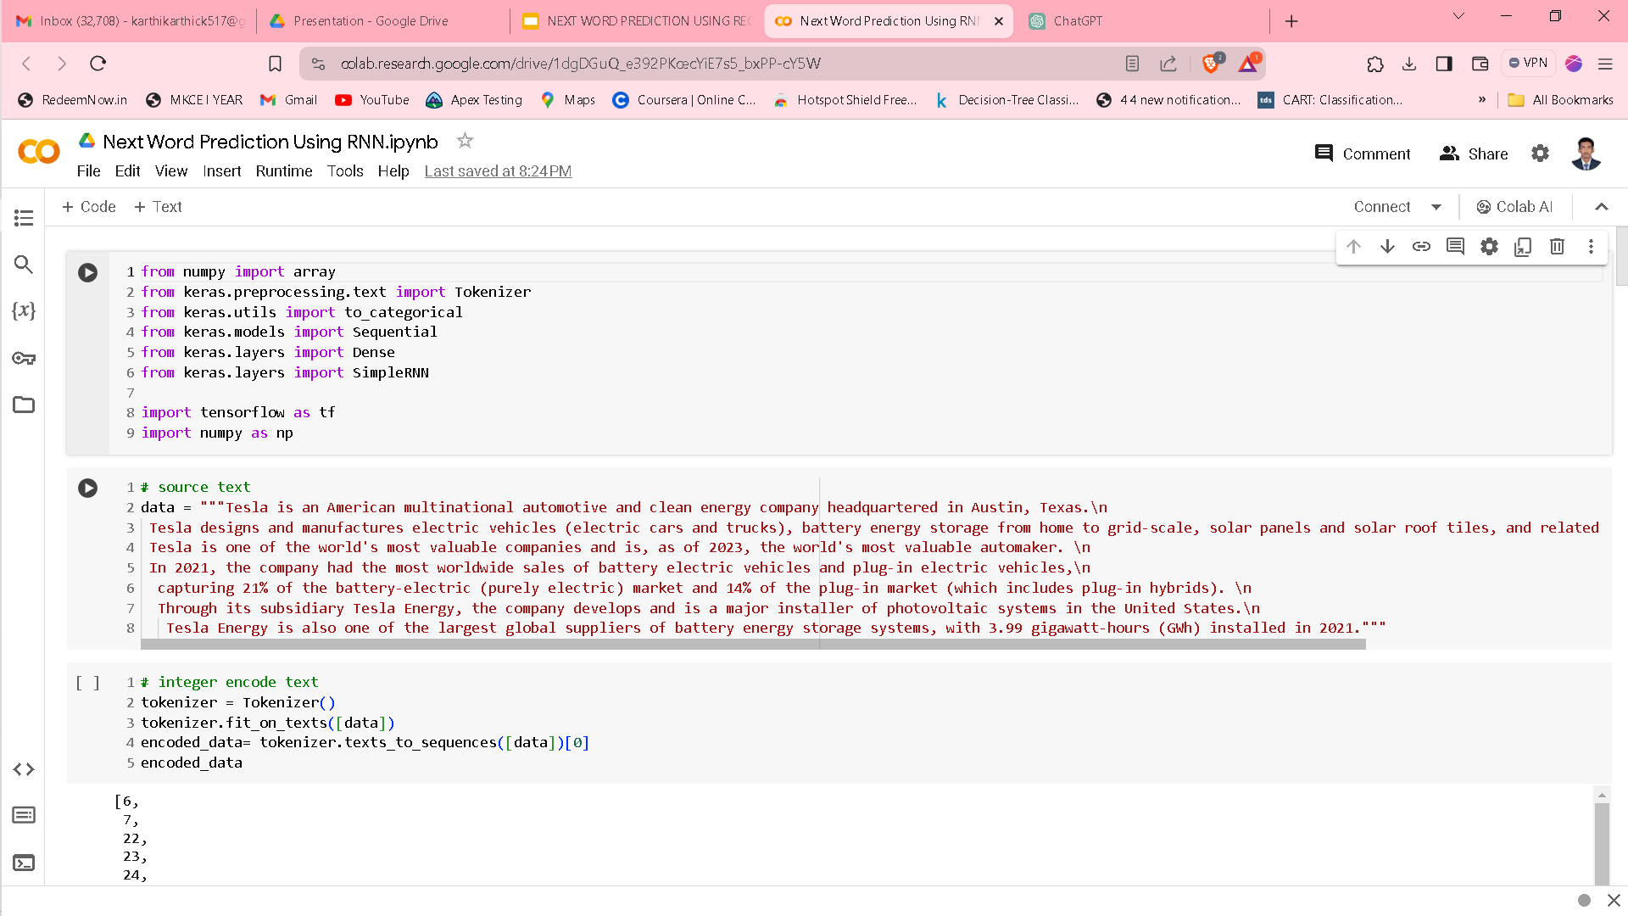
SOURCE TEXT

Slide 7
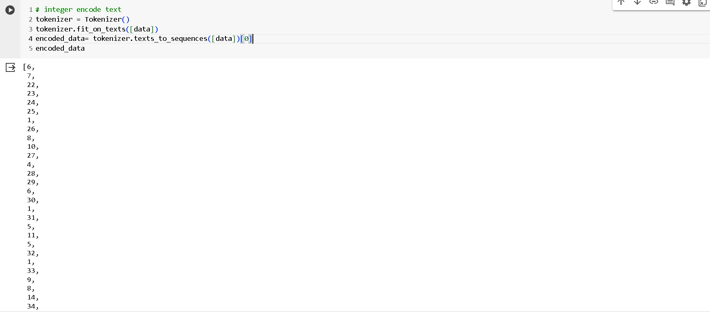
INTEGER ENCODING

Slide 8
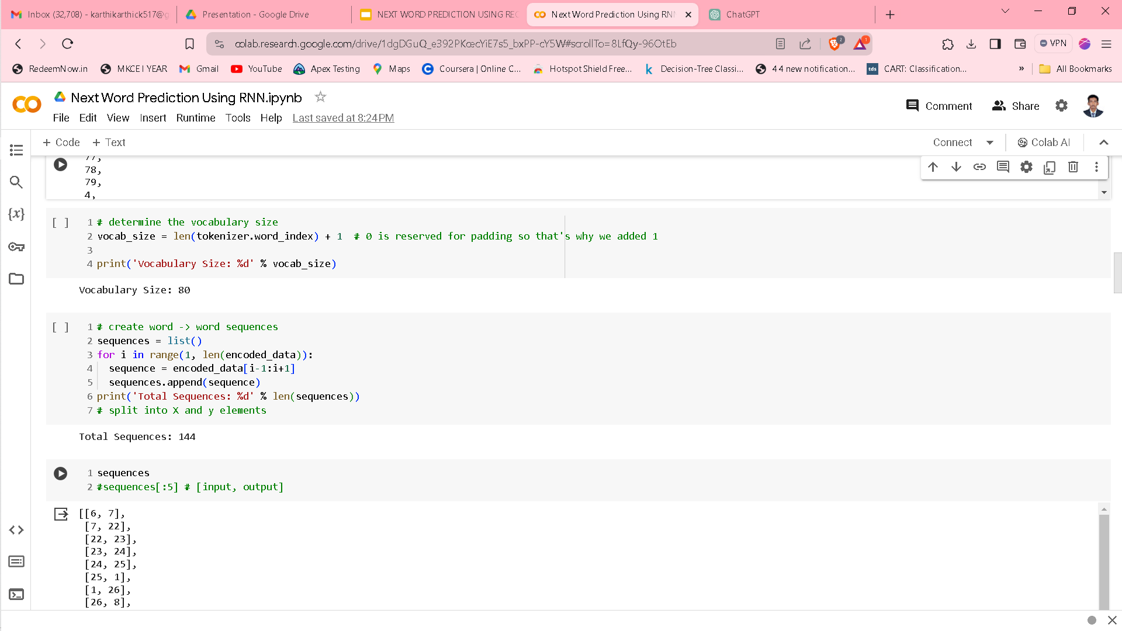
VOCABULARY SIZE

Slide 9
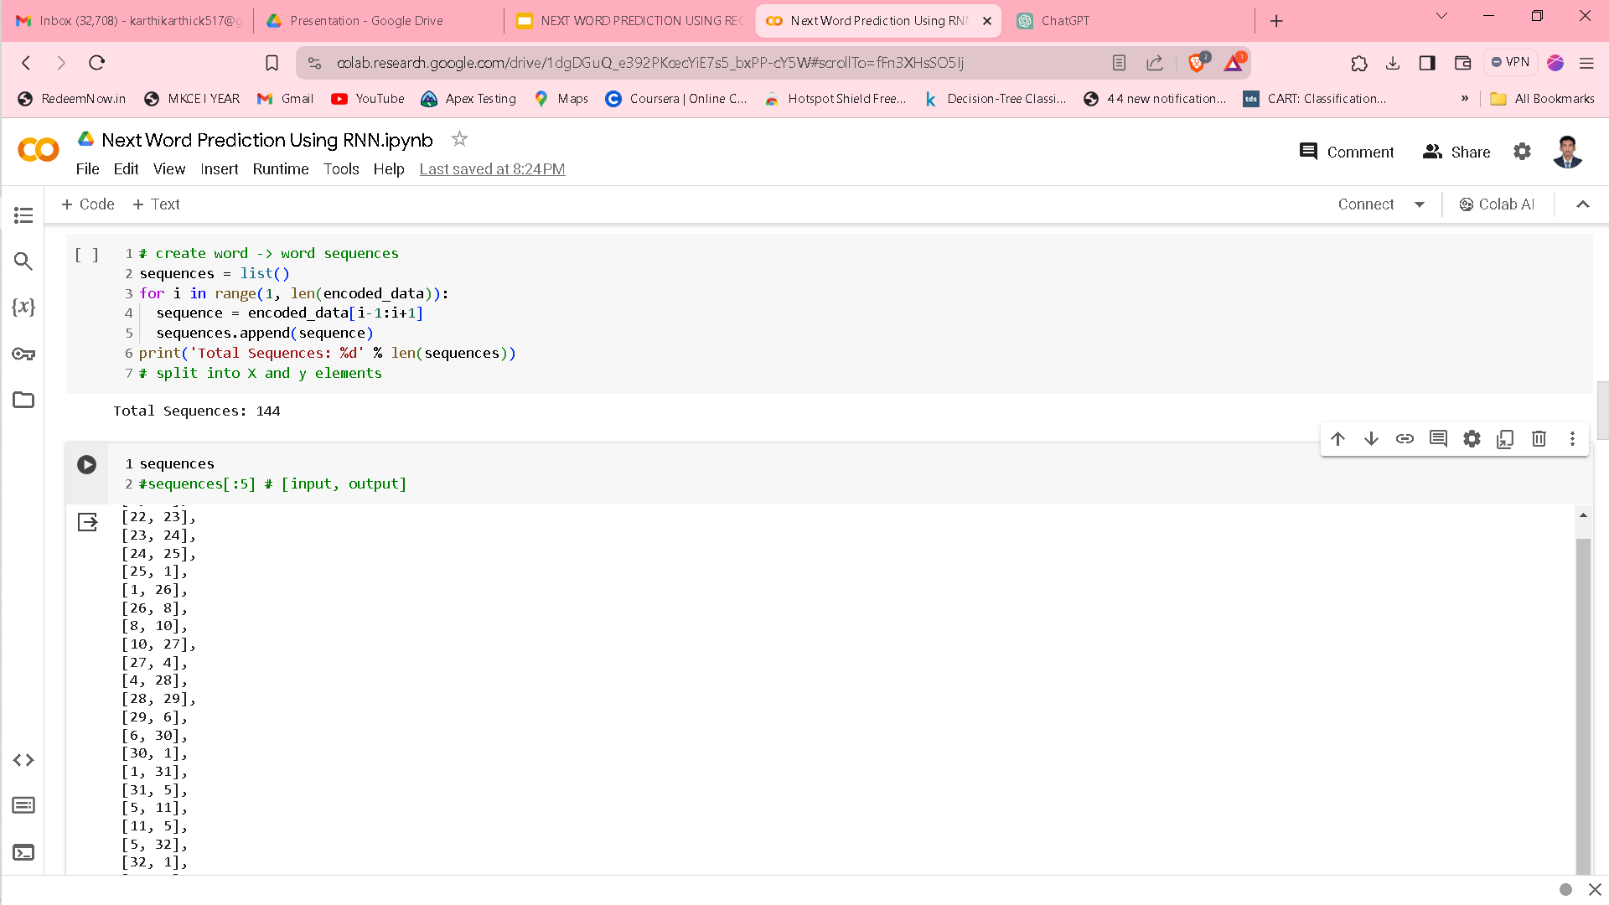
WORD SEQUENCES

Slide 10
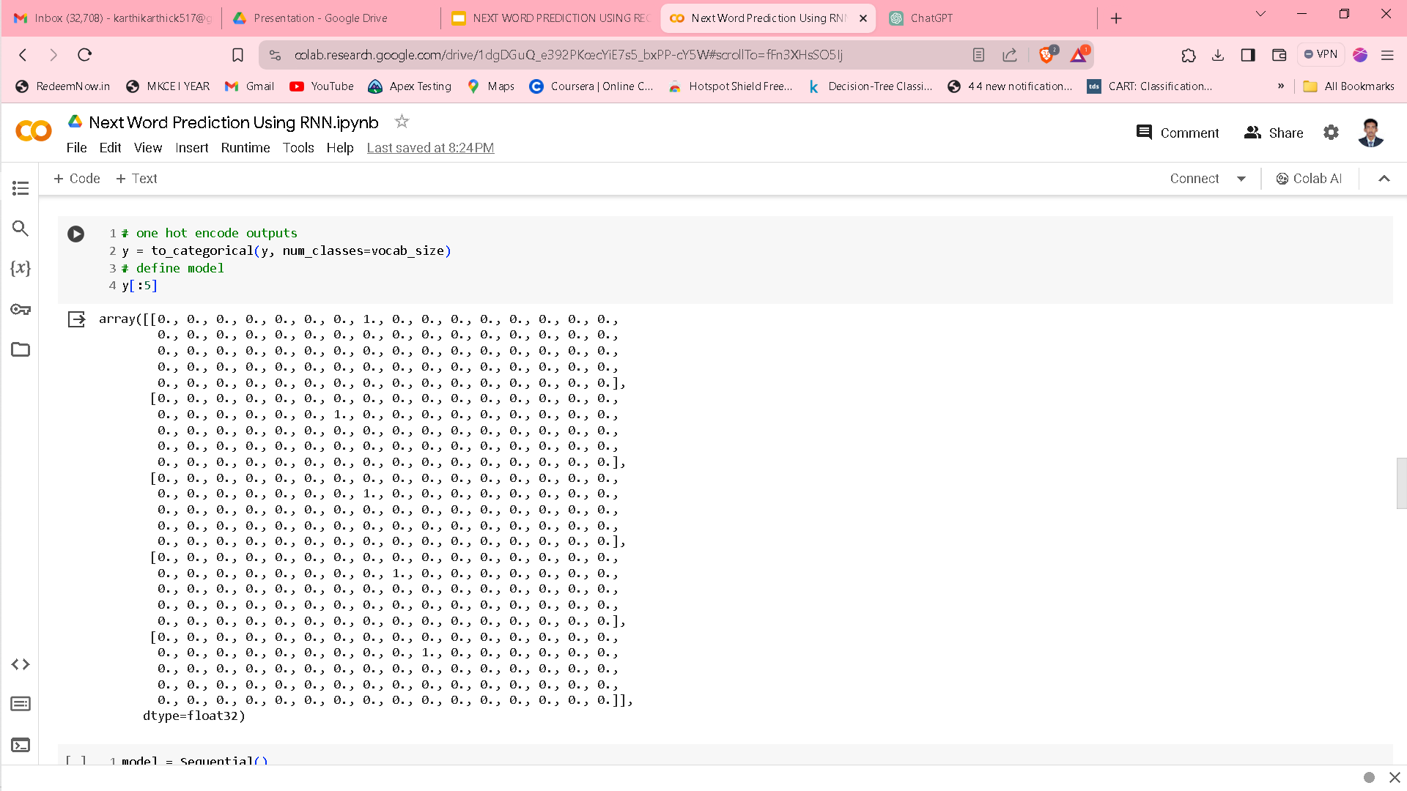
DATA ENCODING

Slide 11
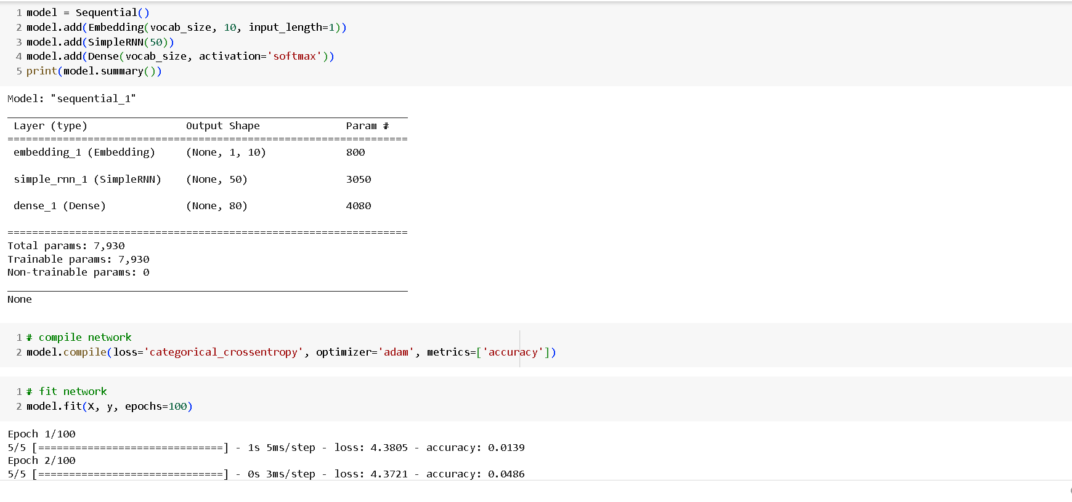
MODEL BUILDING

Slide 12
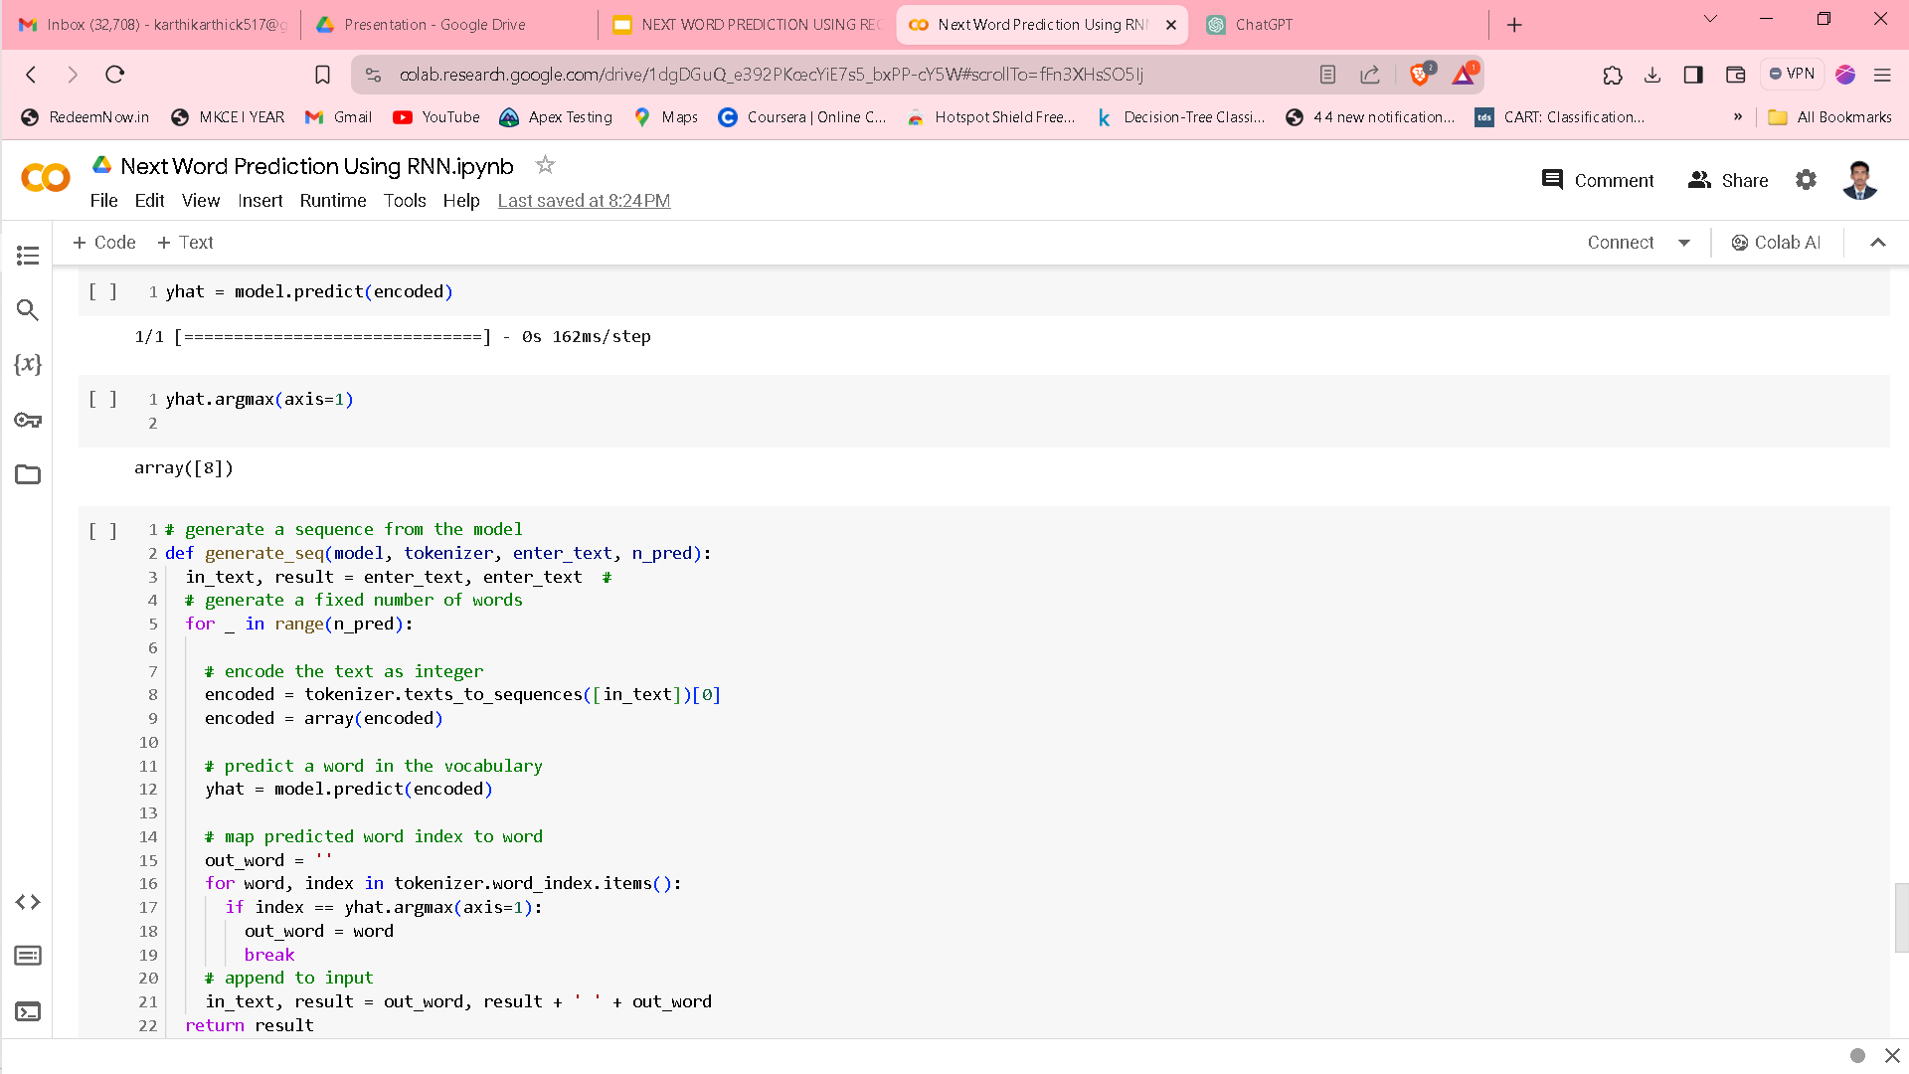
SEQUENCE GENERATION

Slide 13
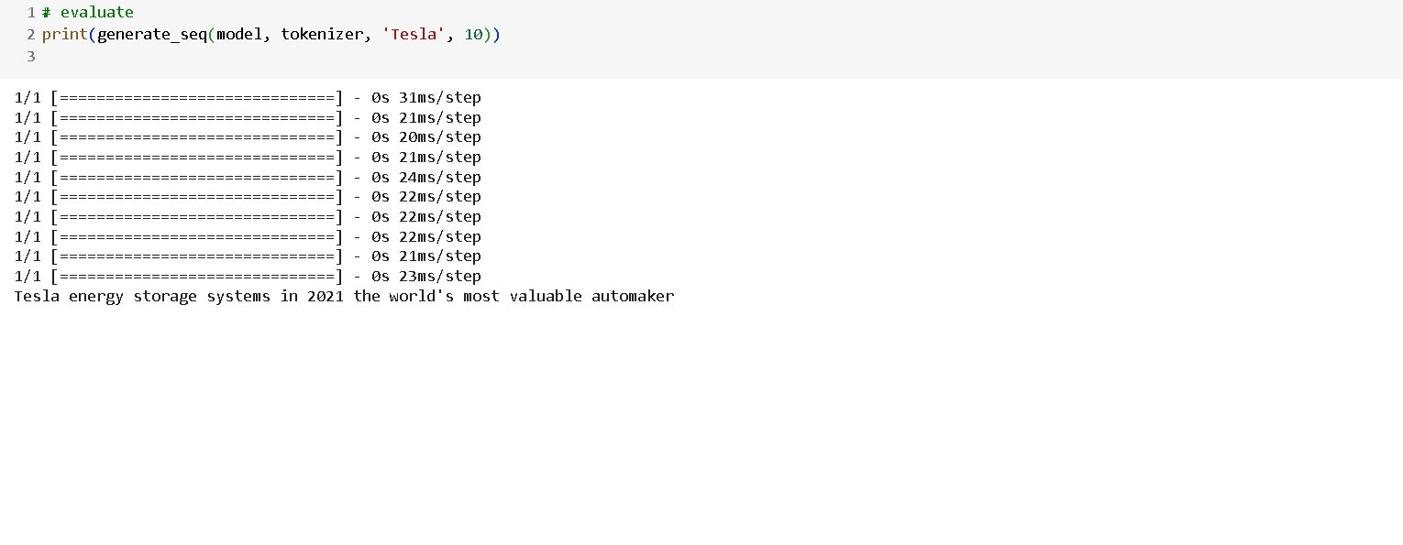
EVALUATION

Slide 14
CONCLUSION
Next word prediction employing Recurrent Neural Networks (RNNs) significantly boosts user typing efficiency across digital platforms, marking a notable advancement in text input technologies.
The ongoing refinement of machine learning algorithms and the analysis of extensive text datasets promise further improvements in prediction accuracy and context sensitivity, underscoring the importance of continued research in natural language processing.

